Slide 1
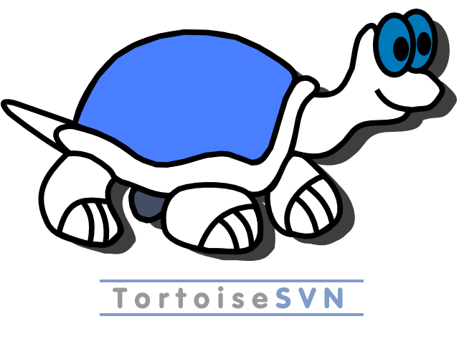
1.7 and Beyond
[insert SVeN here]

Slide 2
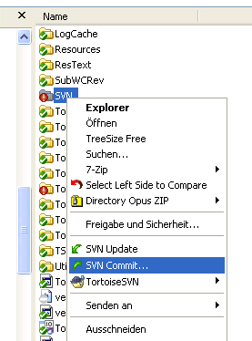
What is TortoiseSVN
The SVN client on Windows
Integrated into Explorer
Indicate w/c state as overlay
Accessible from any application
Exceeds basic SVN functionality
Extensive documentation
Available in > 30 languages

Slide 3
What Happened Since 1.6.0
22 months of development
4159 commits (1868 src, 2291 doc and others)
48 new features
16 feature improvements
2 unreleased bug fixes
116 bug fixes and 16 other changes released in 1.6.x
(statistics as of 2010-01-05, revision 20666)

Slide 4
New in 1.7.0
Full SVN 1.7 feature support
Log dialog
  fast even for > 1 million revs
  search-engine-like complex filter
  highlight matching strings
  multi-select displays shortened summary of messages
  revisions mentioned in messages are turned into links
  export of changed items

Slide 5
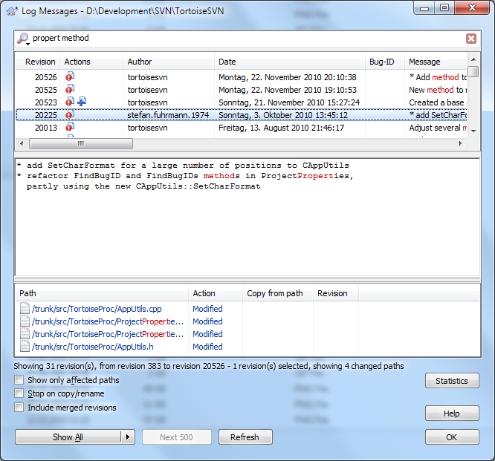
Log Dialog Demo
[log dialog screenshot]

Slide 6
New in 1.7.0
OS support
  Windows 7 Aero look and libraries
  64 bit installer also includes support for 32 bit applications
Repository browser
  shows svn:externals as sub-trees
  edit files directly
  drag to explorer to create an URL link
  pre-fetch sub-folder content using parallel queries

Slide 7
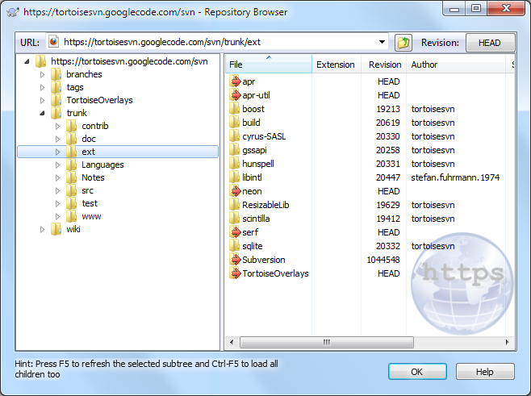
Repository Browser Demo

Slide 8
Workflow Enhancements
Adjusting externals to a fixed revision when branching or tagging
Check-out dialog supports single files and multi-select
New dialog for sparse checkouts
Offer automatic update and retry if a commit failed due to an outdated working copy
More command line options
TortoiseUDiff can operate from stdin ("pipe")

Slide 9
Other Improvements
Custom dialogs to edit specific properties
New, particularly small, overlay icon set
Option only to add the TSVN menu items for SVN w/cs
URL handler for TSVN commands
Various small improvements all over the place, e.g. TMerge
More general feature availability

Slide 10

1.8 and Beyond

Slide 11
Fast and Efficient
Further SVN speedup allows for pre-fetching logs and w/c data
Off-line commits open a whole new world of possibilities
New client-side features, e.g. partial file commits
Streamline workflows
  Reduce clicks and UI complexity
  Re-use information like last URLs everywhere
  Display repository content inside the Explorer

Slide 12
Chatty Cathy – A Wild Idea
Aim-like application fed from TSVN and user-defined agents
Inform user on various events and suggest SVN actions
  Check-in by other user
  Detect [potential] conflicts and required updates
  User-defined checks on properties
  Suggest commits
Accept / reject / postpone suggested actions with a single click

Slide 13
(T)SVN in 2020
SVN can be the fastest and most powerful SCM system
  Servers can afford for expensive HW and optimizations
  Cascading repository setups (i.e. DVCS) feasible
  C/S architectures tend to handle multi-core clients better
Maybe, learn the difference between content and containers
  Users modify code and documents (content)
  Most SCM systems manage files (containers)
  Mismatch makes changes like refactoring hard

